Slide 1
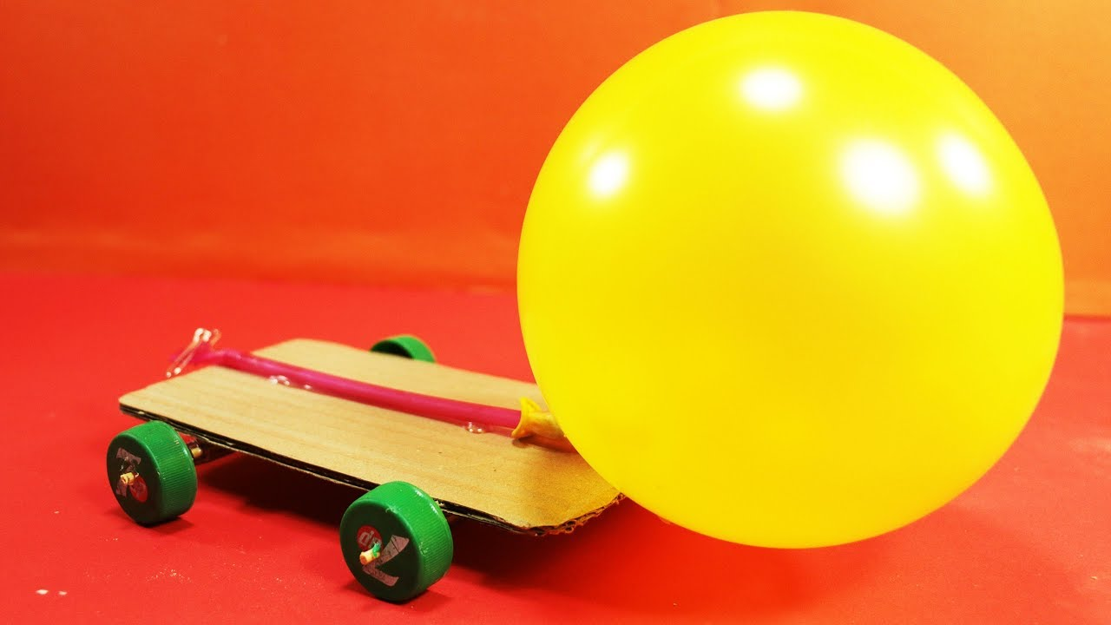
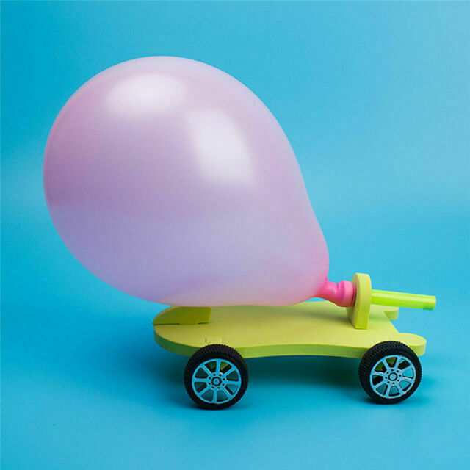
Balloon-Powered Cars!
SCIENCE TOPICS: energy, Newton’s 3rd Law of Motion, air pressure, engineering
BACKGROUND: Have you ever blown up a balloon? What happens? The air wants to escape from the balloon, right? Why does that happen? There are two reasons we’ll think about. First, when you blow air into a balloon, you add tiny air particles. These tiny particles have a tiny amount of force -- which we call air pressure -- that the walls of the balloon feel. When we add more air, we are increasing the air pressure inside the balloon. When the air pressure is too high, the air wants to escape.
At the same time, the balloon is forcing the air to escape. What does a balloon look like when it doesn’t have air? It’s small and shrivelled up. When you blow air into the balloon, you stretch the balloon, making it bigger. You also increase the balloon’s elastic energy -- the energy created by the fact that the balloon wants to become small and shrivelled up. When you stop blowing up the balloon, the balloon forces the air out of the balloon so that it can become shrivelled. The elastic energy of the balloon changes to kinetic energy. This is the energy of movement of the air out of the balloon.
So, how does the balloon help the car move? This is because of energy and Newton’s 3rd Law of Motion, the idea that every action has an equal and opposite reaction. This means when the air shoots out from the back of the car, the car moves forward. The car moving forward is the opposite reaction of the air leaving the balloon.

Slide 2
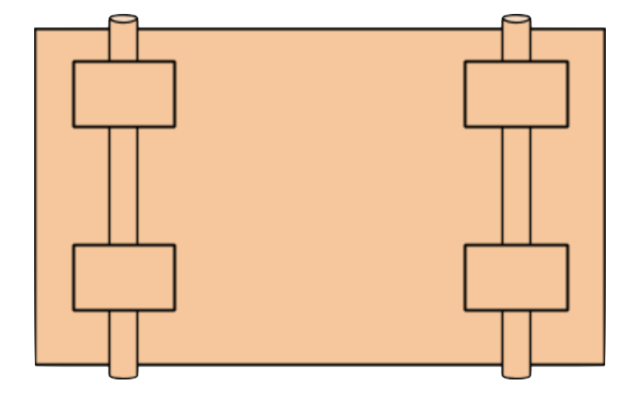
2
YOU WILL NEED…
Cardboard/strong base material
Tape (Duct/Scotch is preferred)
1 Balloon
2-3 straws
scissors
PROCEDURE
Cut out a 3x6 inch cardboard rectangle to serve as the “base” of your car.
Cut two 3 inch pieces from the straw and use tape to secure them to the bottom of your base piece. These will serve as the axles of your car, so attach them in a parallel fashion as shown.
Trim the rolled mouthpiece off of the end of the balloon. Insert the remaining straw into the balloon and secure with tape to create an airtight seal.
Use tape to secure the straw/balloon to the top of your car. Make sure that the end of the straw hangs over the edge of the 3’’ side of your base-piece.
Cut out four cardboard circles of about a 1½ inch diameter. (Punch or cut a hole in the center of each of the four disks)
Slide each of the cardboard disks onto the “axles” of your car.
Blow up your balloon through the straw, cover the opening, place on a flat surface, and release when you are ready! Record observations/measurements below.

Slide 3
3
PREDICTIONS/HYPOTHESES - will the car move? If so, how fast? What do you believe will happen? Why do believe this will happen?
__________________________________________________________
__________________________________________________________
__________________________________________________________
EXPERIMENTAL RESULTS/OBSERVATIONS
Run Number | Car Direction (Did your car veer left/right?) | Distance Traveled (meters) | Travel Time (seconds) | Car Speed (meters/second) | Additional Notes and Observations
1
2
3
4
5

Slide 4
4
QUESTIONS TO CONSIDER
What factors influence the speed of the car and the distance it travels? _____________________________________________________________________
__________________________________________________________________________________________________________________________________________________________
Why is it important that you performed multiple “runs” or recorded more than one measurement with your car? _____________________________________________
__________________________________________________________________________________________________________________________________________
Where did you see energy, Newton’s 3rd Law of Motion, and air pressure action? How and why did they affect the results? ___________________________________
______________________________________________________________________________________________________________________________________________________________________________________________________________
Where else have you observed energy, Newton’s 3rd Law of Motion, and air pressure in real life? ____________________________________________________
__________________________________________________________________________________________________________________________________________
How would you improve and/or change your car if you were to do this experiment again? Why? __________________________________________________________
__________________________________________________________________________________________________________________________________________
WE HOPE YOU HAD FUN!

