Slide 1
GARDEN INSECT BIODIVERSITY
Kendra Ing

Slide 2
Why biodiversity?
Every organism has a role to play!
More species → more productivity → thriving ecosystem
Understand who is in our immediate environment
How do they contribute to the ecosystem?
How can we support the biodiversity?

Slide 3
Goals for this project!
Encourage people to explore biodiversity in their gardens!
Exploring in an familiar setting keeps it relevant - why should we care?
Spark curiosity in younger generations!
Starting the conversation early stimulates awareness, appreciation, allowing it to be important!
Create a booklet for the gardens to keep and refer to
Making the knowledge accessible to people spending time in the garden!

Slide 4
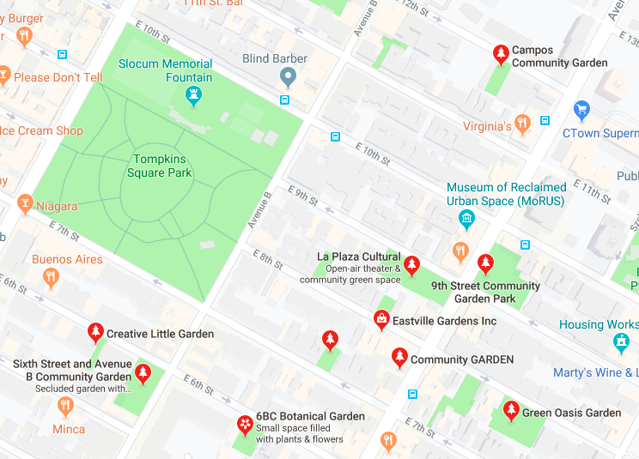
Lower East Side, Manhattan

Slide 5
Methods
 | Date: July 2019 | Weather | Sampling method | Location
Green Oasis | 25th 30th | 27°C, 51% humidity, sunny 29°C, 61% humidity, sunny, overnight rain | Pitfall traps x4, Pan traps x1 | Corners of the garden Among tall flowering plants
Campos | 25th 30th | 27°C, 51% humidity, sunny 29°C, 61% humidity, sunny, overnight rain | Pitfall traps x4, Pan traps x1 +1 pan trap | Corners of the garden Among tall flowering plants
Sixth St. and Ave. B | 18th 25th | 27°C, cloudy 27°C, 47% humidity, sunny | Aspirator x1 Aerial net x1 | Compost bins Tall flowering plants, high-up areas
Varied by garden based on each garden’s rules.
Results were tallied and categorized by functional groups.

Slide 6
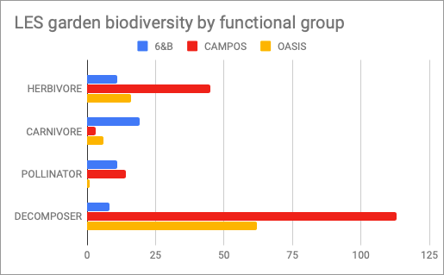
Results
https://docs.google.com/forms/d/e/1FAIpQLScmAEUxlhByoPTu_BWuYaZAEUjiIhAL3nxwbk9PE597z7Ywmw/viewform
TOTAL = 309 bugs!

Slide 7
Continuing the work...
Interpreting results for biocontrol
What plants attract different species? What are their host plants?
Printables to be given to each garden
Serves as a scavenger-hunt-esque activity for everyone to do!
An index of insects that can already be found in the garden!

